Slide 1

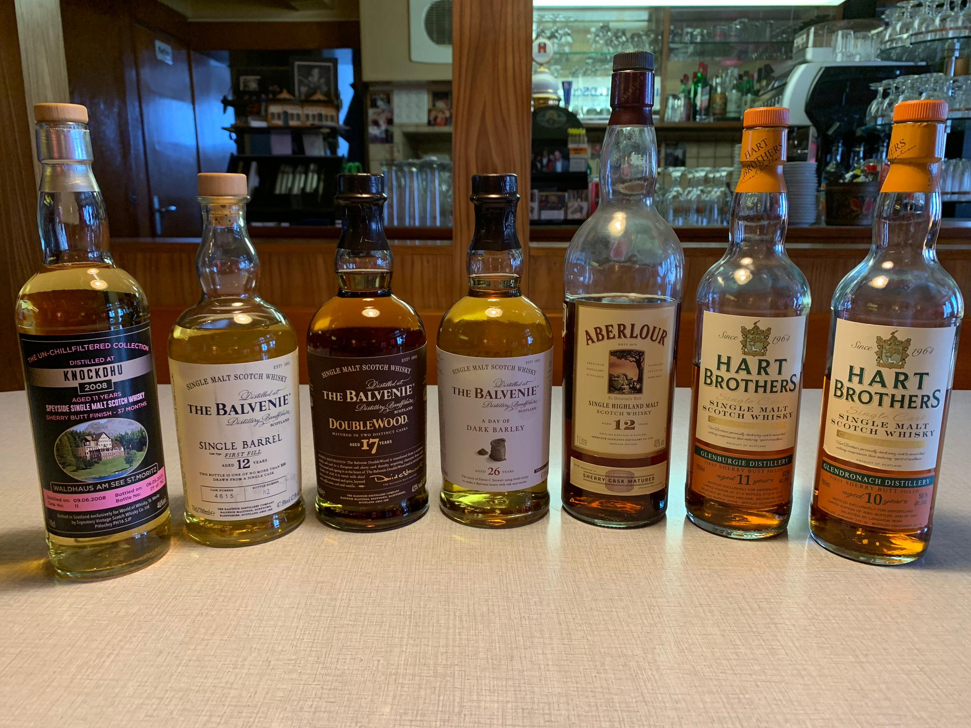
SEVENTEEN DRAMS
ONLINE TASTING 02. Februar 2021

Slide 2
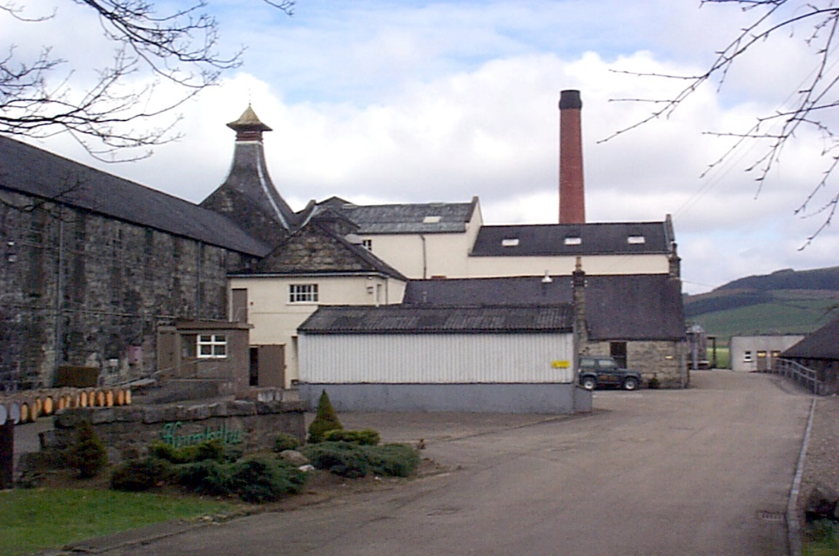
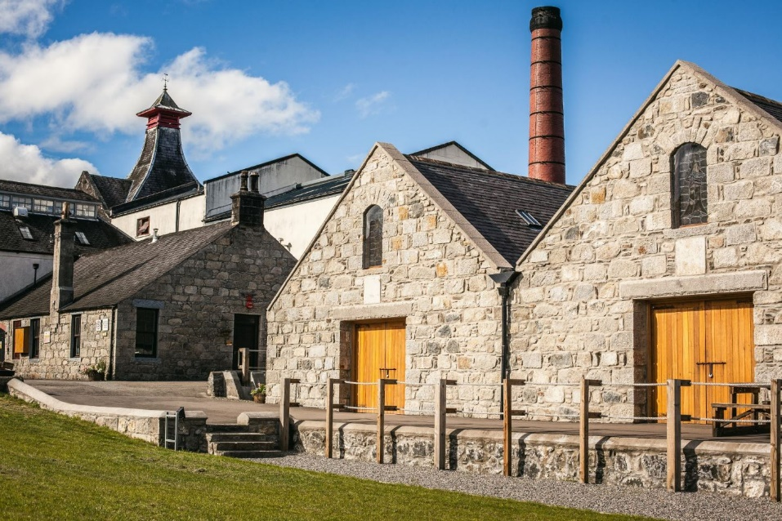
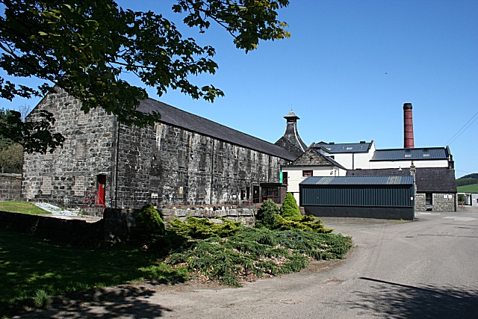
SEVENTEEN DRAMS
knockdhu Estd. 1893 highlands

Slide 3
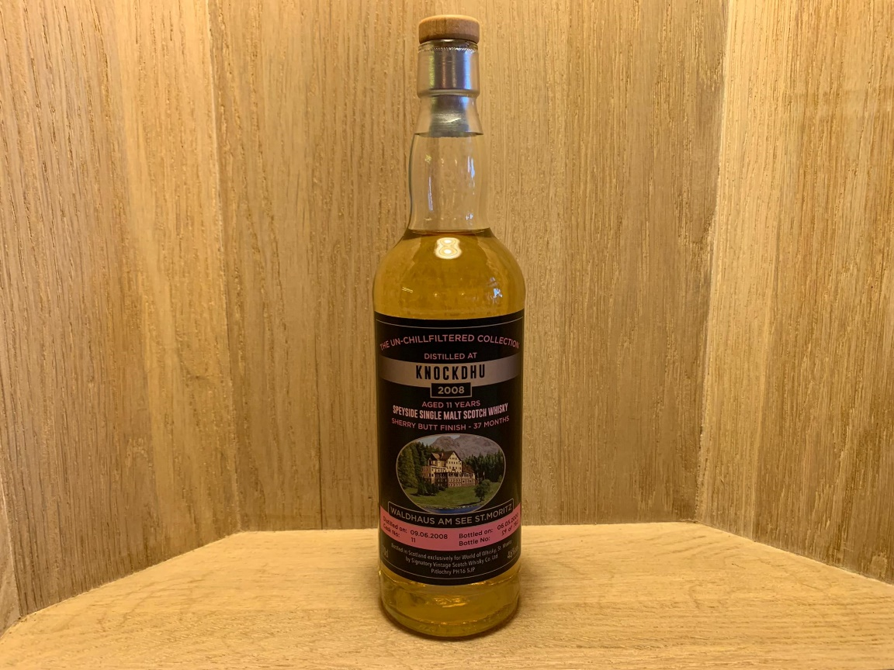
SEVENTEEN DRAMS
KNOCKDHU 2008 11yo signatory for waldhaus cask no. 11 bottle 59 of 762 46%

Slide 4
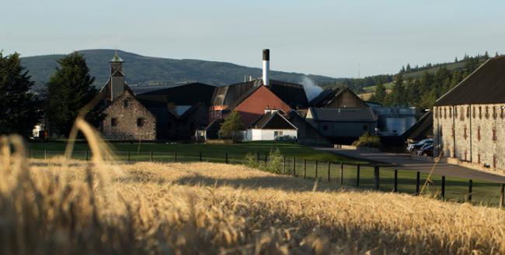
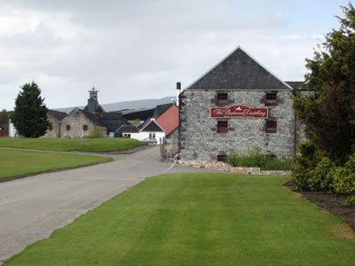
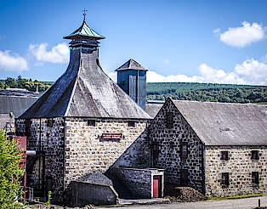
SEVENTEEN DRAMS
The balvenie Estd. 1892 Speyside

Slide 5
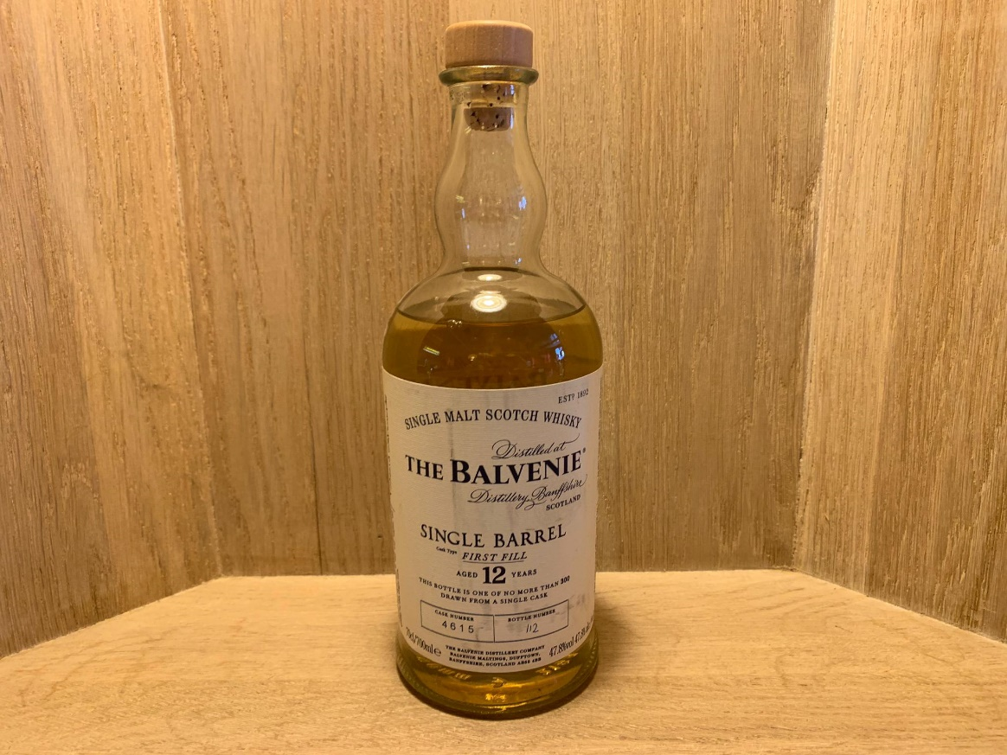
SEVENTEEN DRAMS
Balvenie SINGLE BARREL 12y0 Cask no. 4615 Bottle no. 112 47.8%

Slide 6
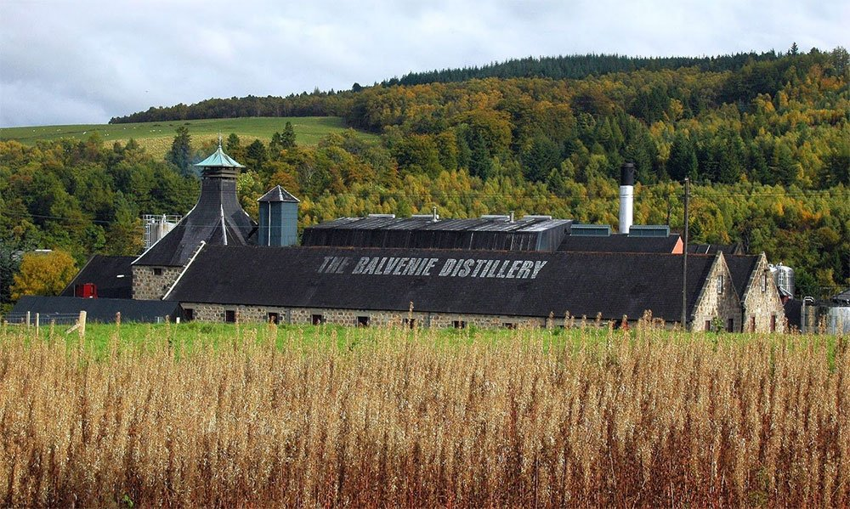
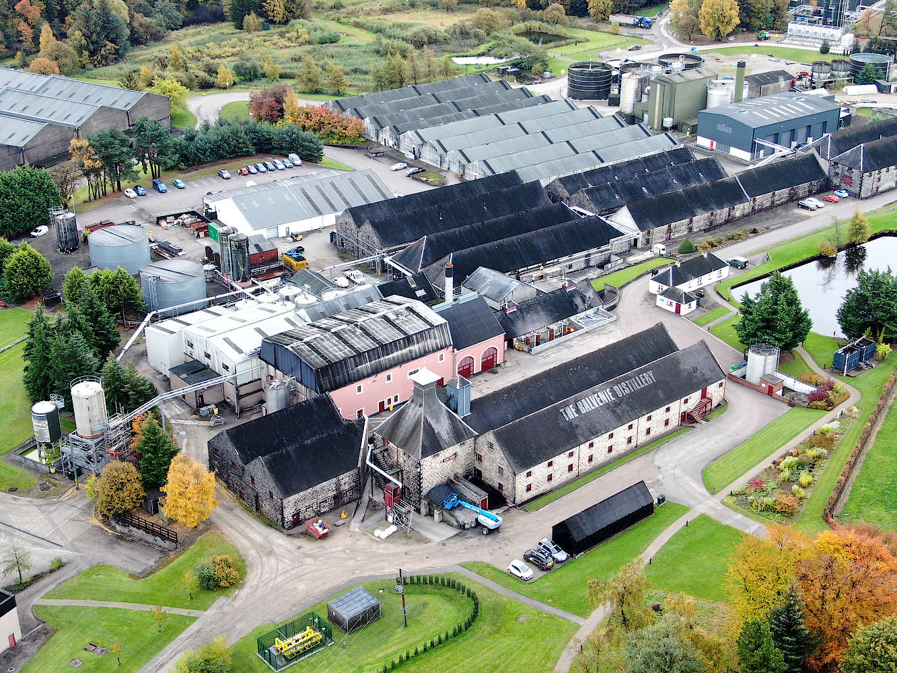
SEVENTEEN DRAMS
The balvenie Estd. 1892 Speyside

Slide 7
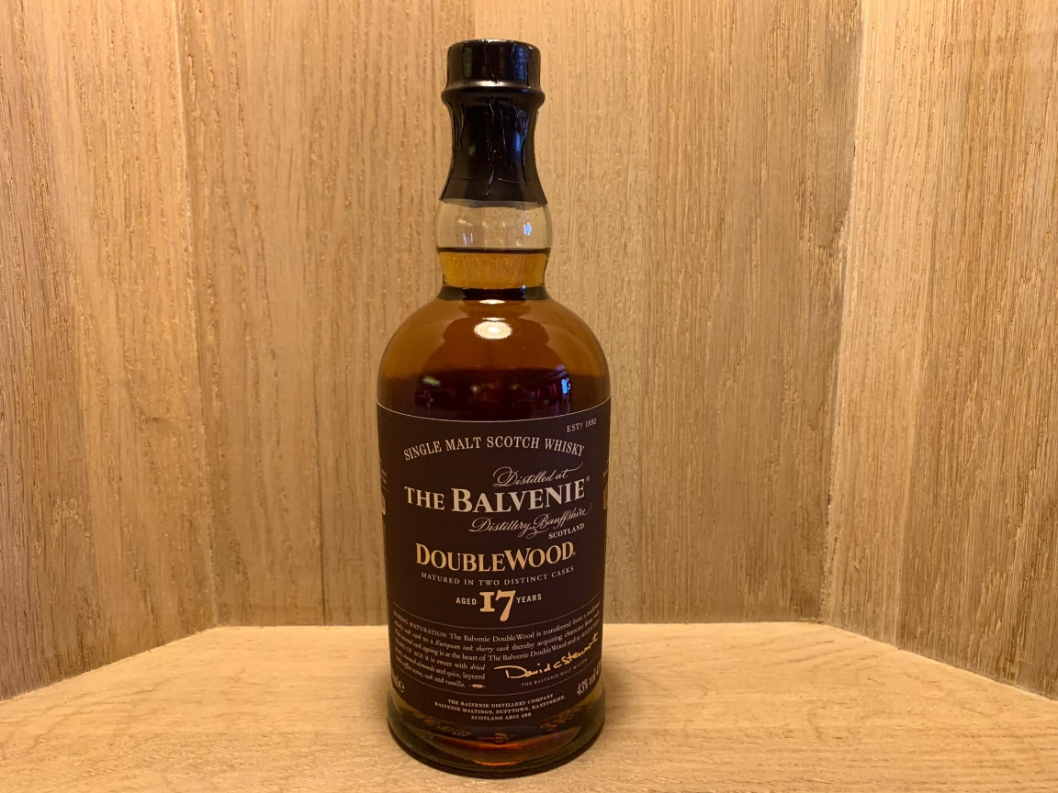
SEVENTEEN DRAMS
Balvenie double wood 17y0 43%

Slide 8
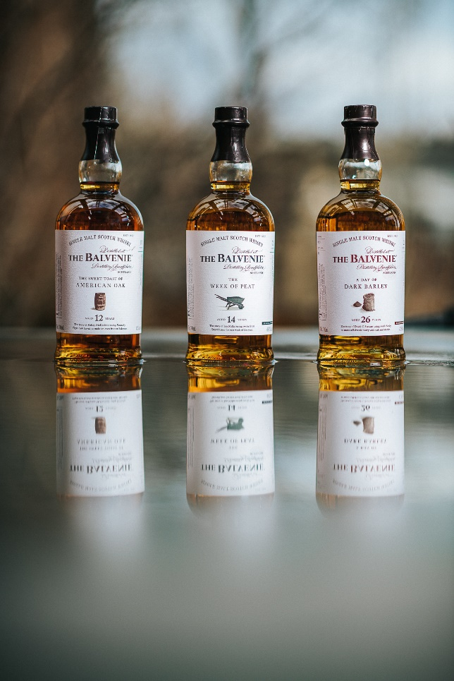
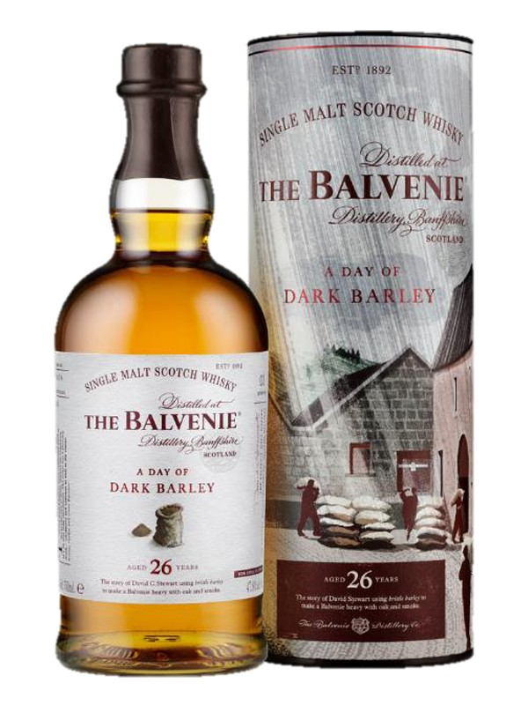
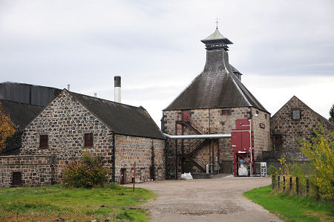
SEVENTEEN DRAMS
The balvenie Estd. 1892 Speyside

Slide 9
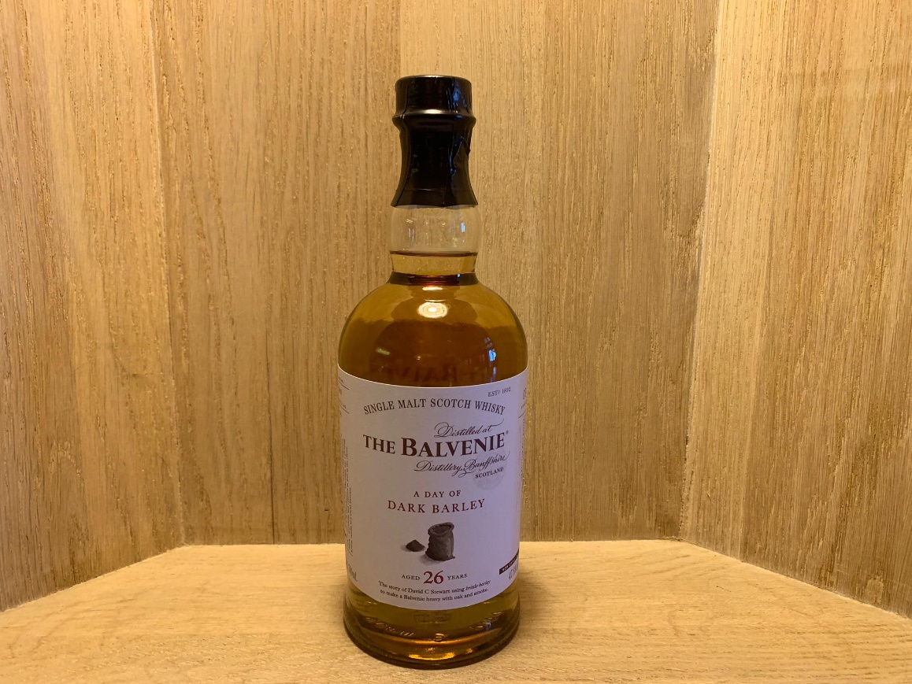
SEVENTEEN DRAMS
Balvenie «a day of dark barley» 26yo 47.8%

Slide 10
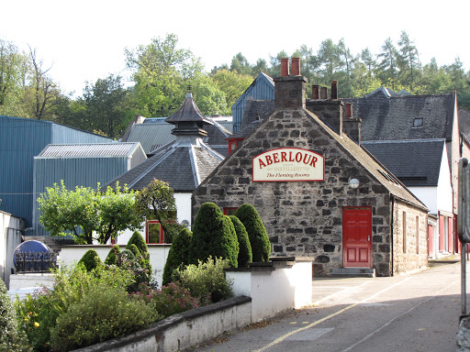
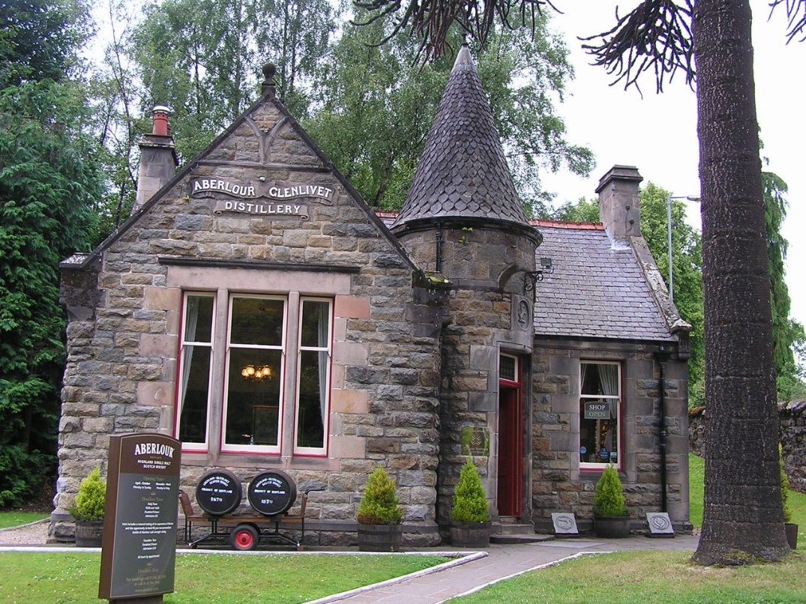
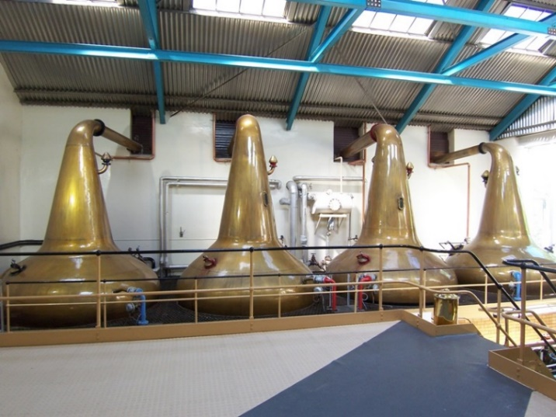
SEVENTEEN DRAMS
aberlour Estd. 1879
speyside

Slide 11
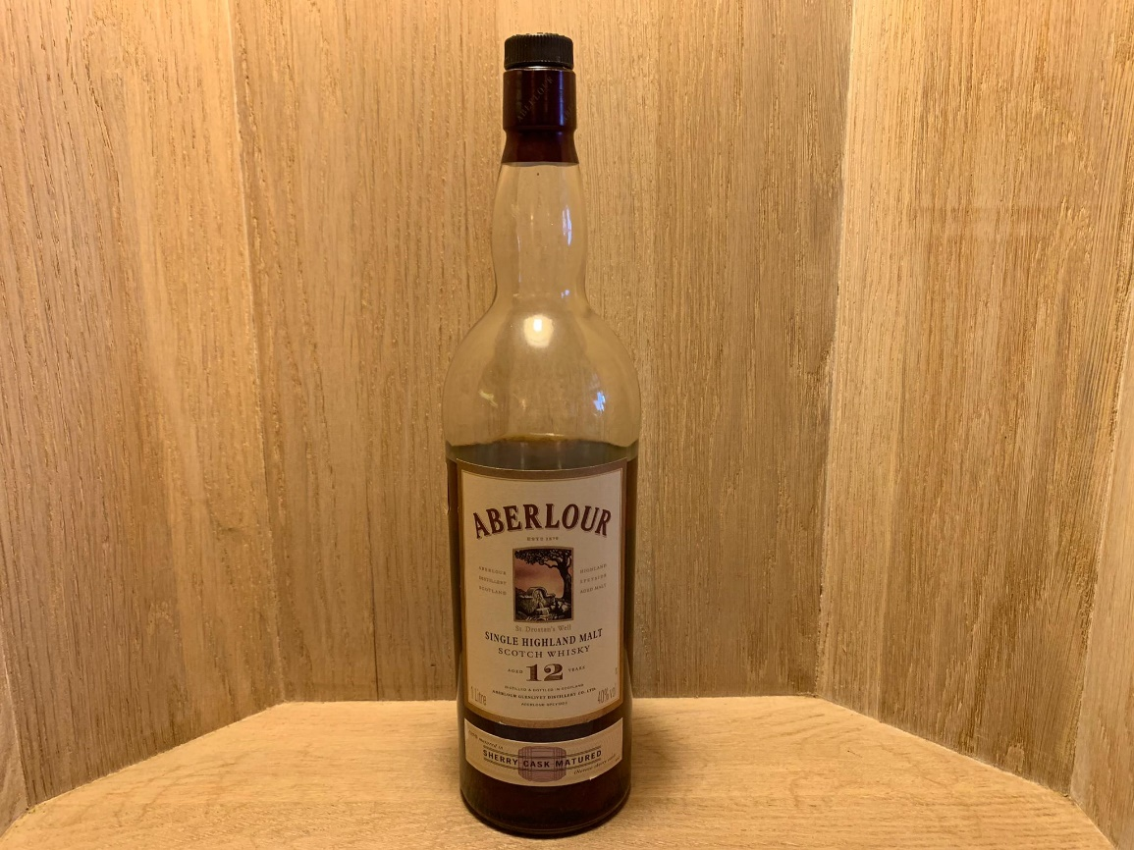
SEVENTEEN DRAMS
Aberlour 12 Yo duty paid sherry cask matured 40%

Slide 12
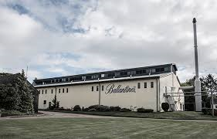


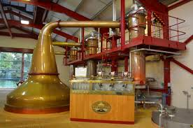
SEVENTEEN DRAMS
glenburgie Estd. 1810
Speyside

Slide 13
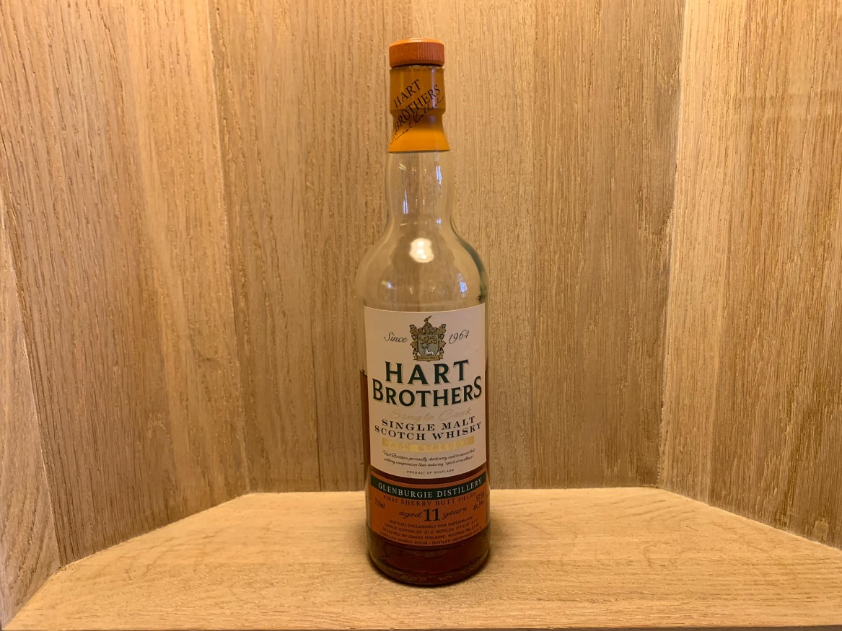
SEVENTEEN DRAMS
Hart brothers for langatun Glenburgie 11yo 2008/2019 57.5%

Slide 14
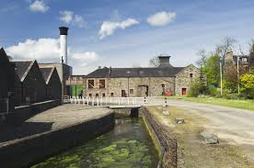
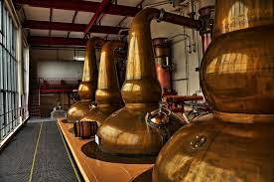
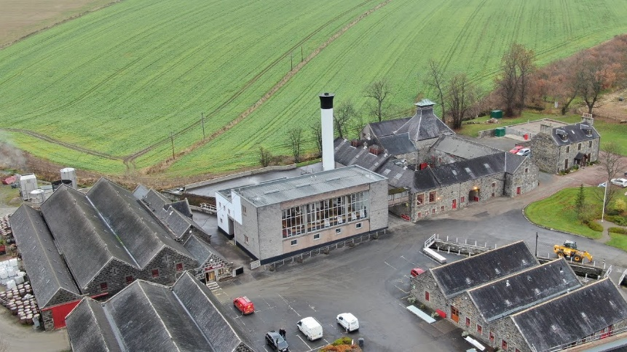
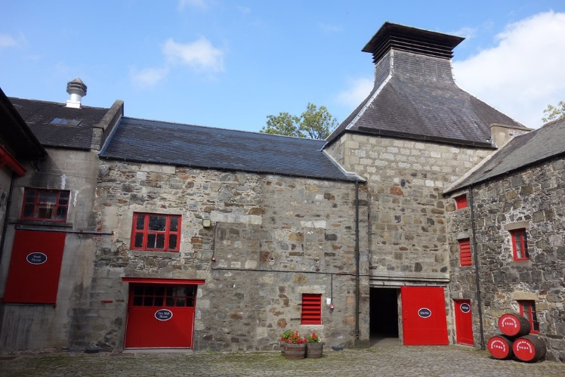
SEVENTEEN DRAMS
glendronach Estd. 1826
Eastern highlands

Slide 15
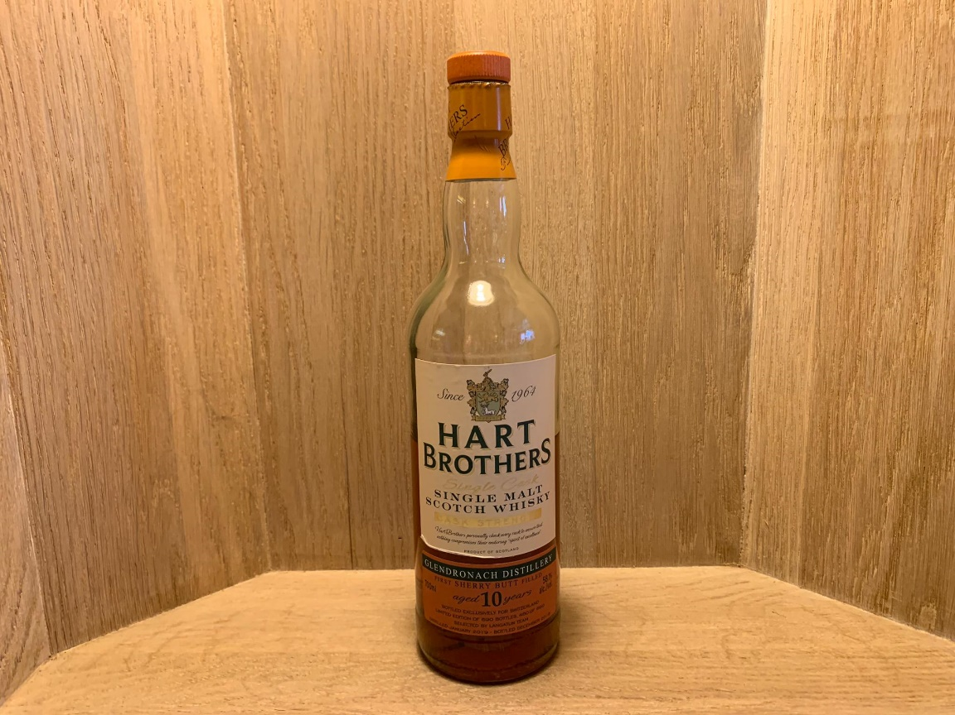
SEVENTEEN DRAMS
Hart brothers for langatun Glendronach 10yo 2009/2019 58.1%

